Slide 1
Distribution of apartments between districts
Alatau Akhmet-Sultan Aksha Ayan Myrzash Abzal

Slide 2
IDEA
Knowledge always has been a problem in society, knowledge about valuable assets in particular is very crucial. Being able to compare/differentiate between two regions will bring a new point of view on data to make decisions.
We have seen prices on households increase over the years, so we’d like to provide information to people about different criteria to base their decisions on. Those criteria could be : average price for squareage, number of commercial objects, criminal rate, etc. .
We have thought of implementing interactive maps which will allow to select regions up to microdistricts/living complexes to compare. Those maps will also show what type of structures are shown and where criminal activities were recorded, and affection range of criminality.

Slide 3
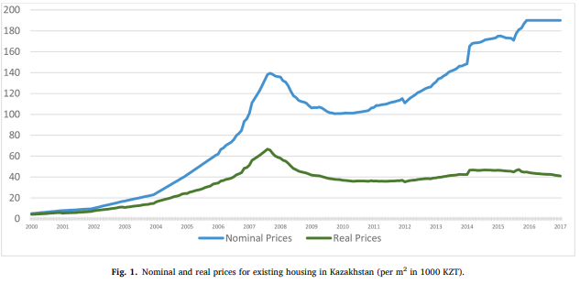
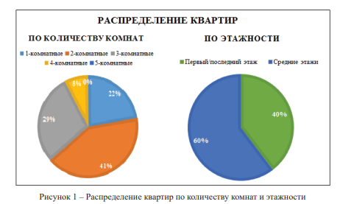
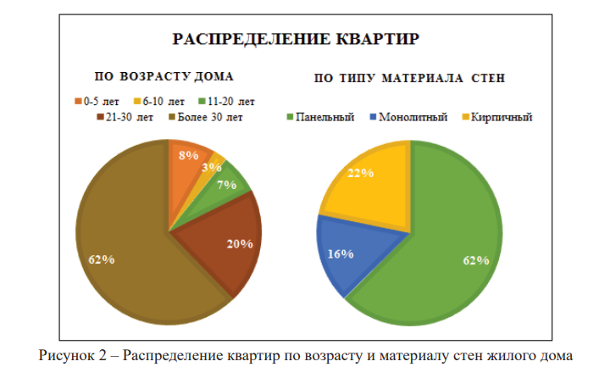
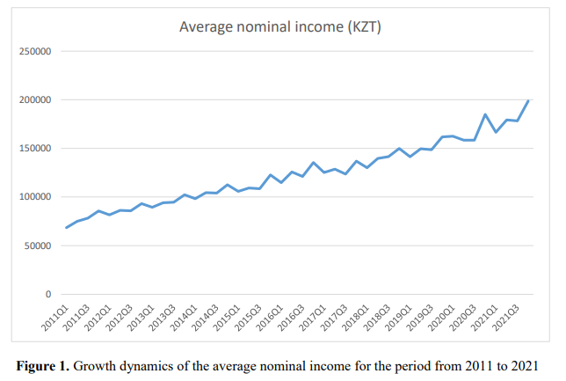
Background

Slide 4
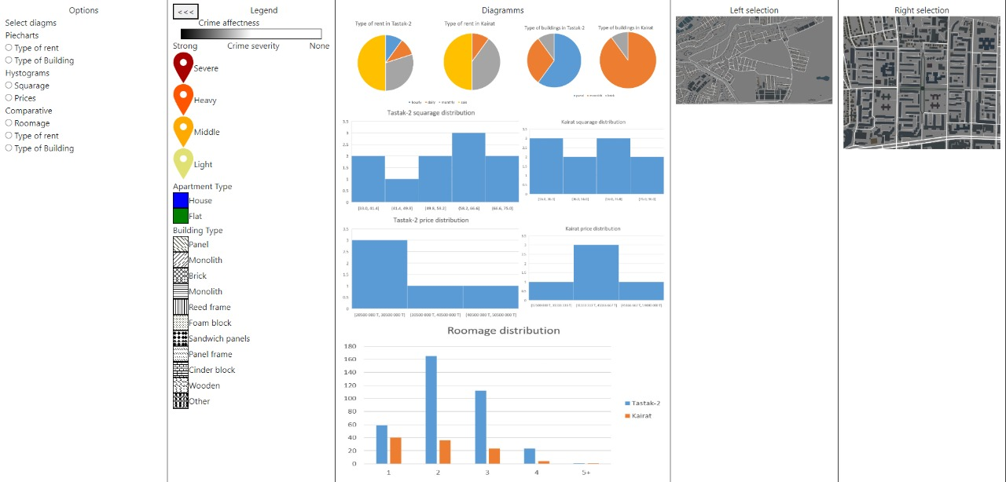
MARK UP

Slide 5
Literature List
[1] - An G., Becker C., Cheng E. Housing price appreciation and economic integration in a transition economy: evidence from Kazakhstan //Journal of Housing Economics. – 2021. – Т. 52. – С. 101765.
[2] - Shulenbayeva G., Issabayev M. REAL ESTATE FAIR VALUE: MODERN APPROACH OF CALCULATION METHODS //Central Asian Economic Review. – 2019. – №. 4. – С. 25-39.
[3] - Kaziyeva A. et al. The impact of economic factors on housing prices. Case of Almaty city. – 2022.

